Slide 1
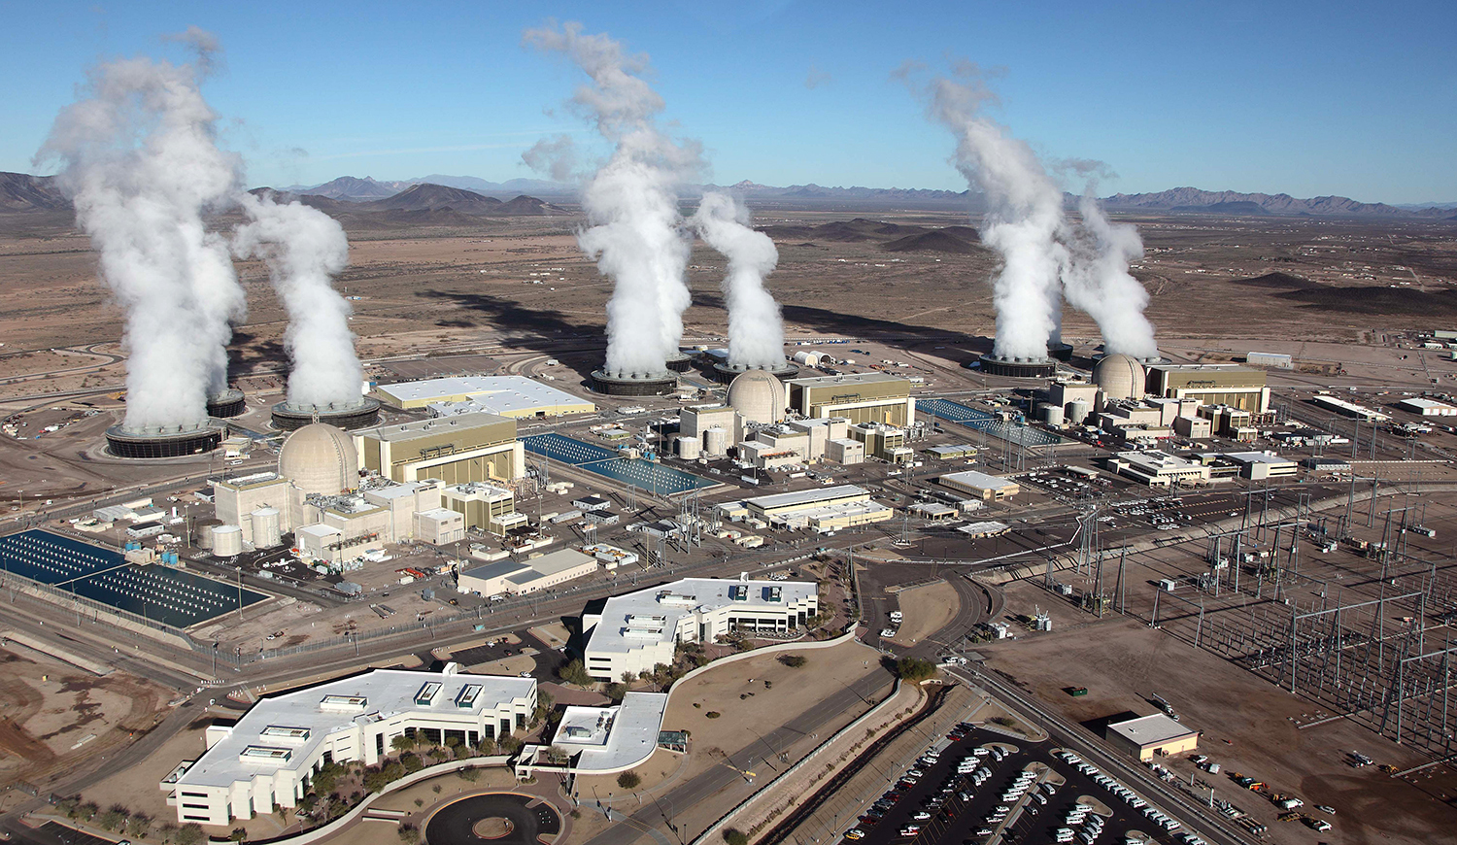

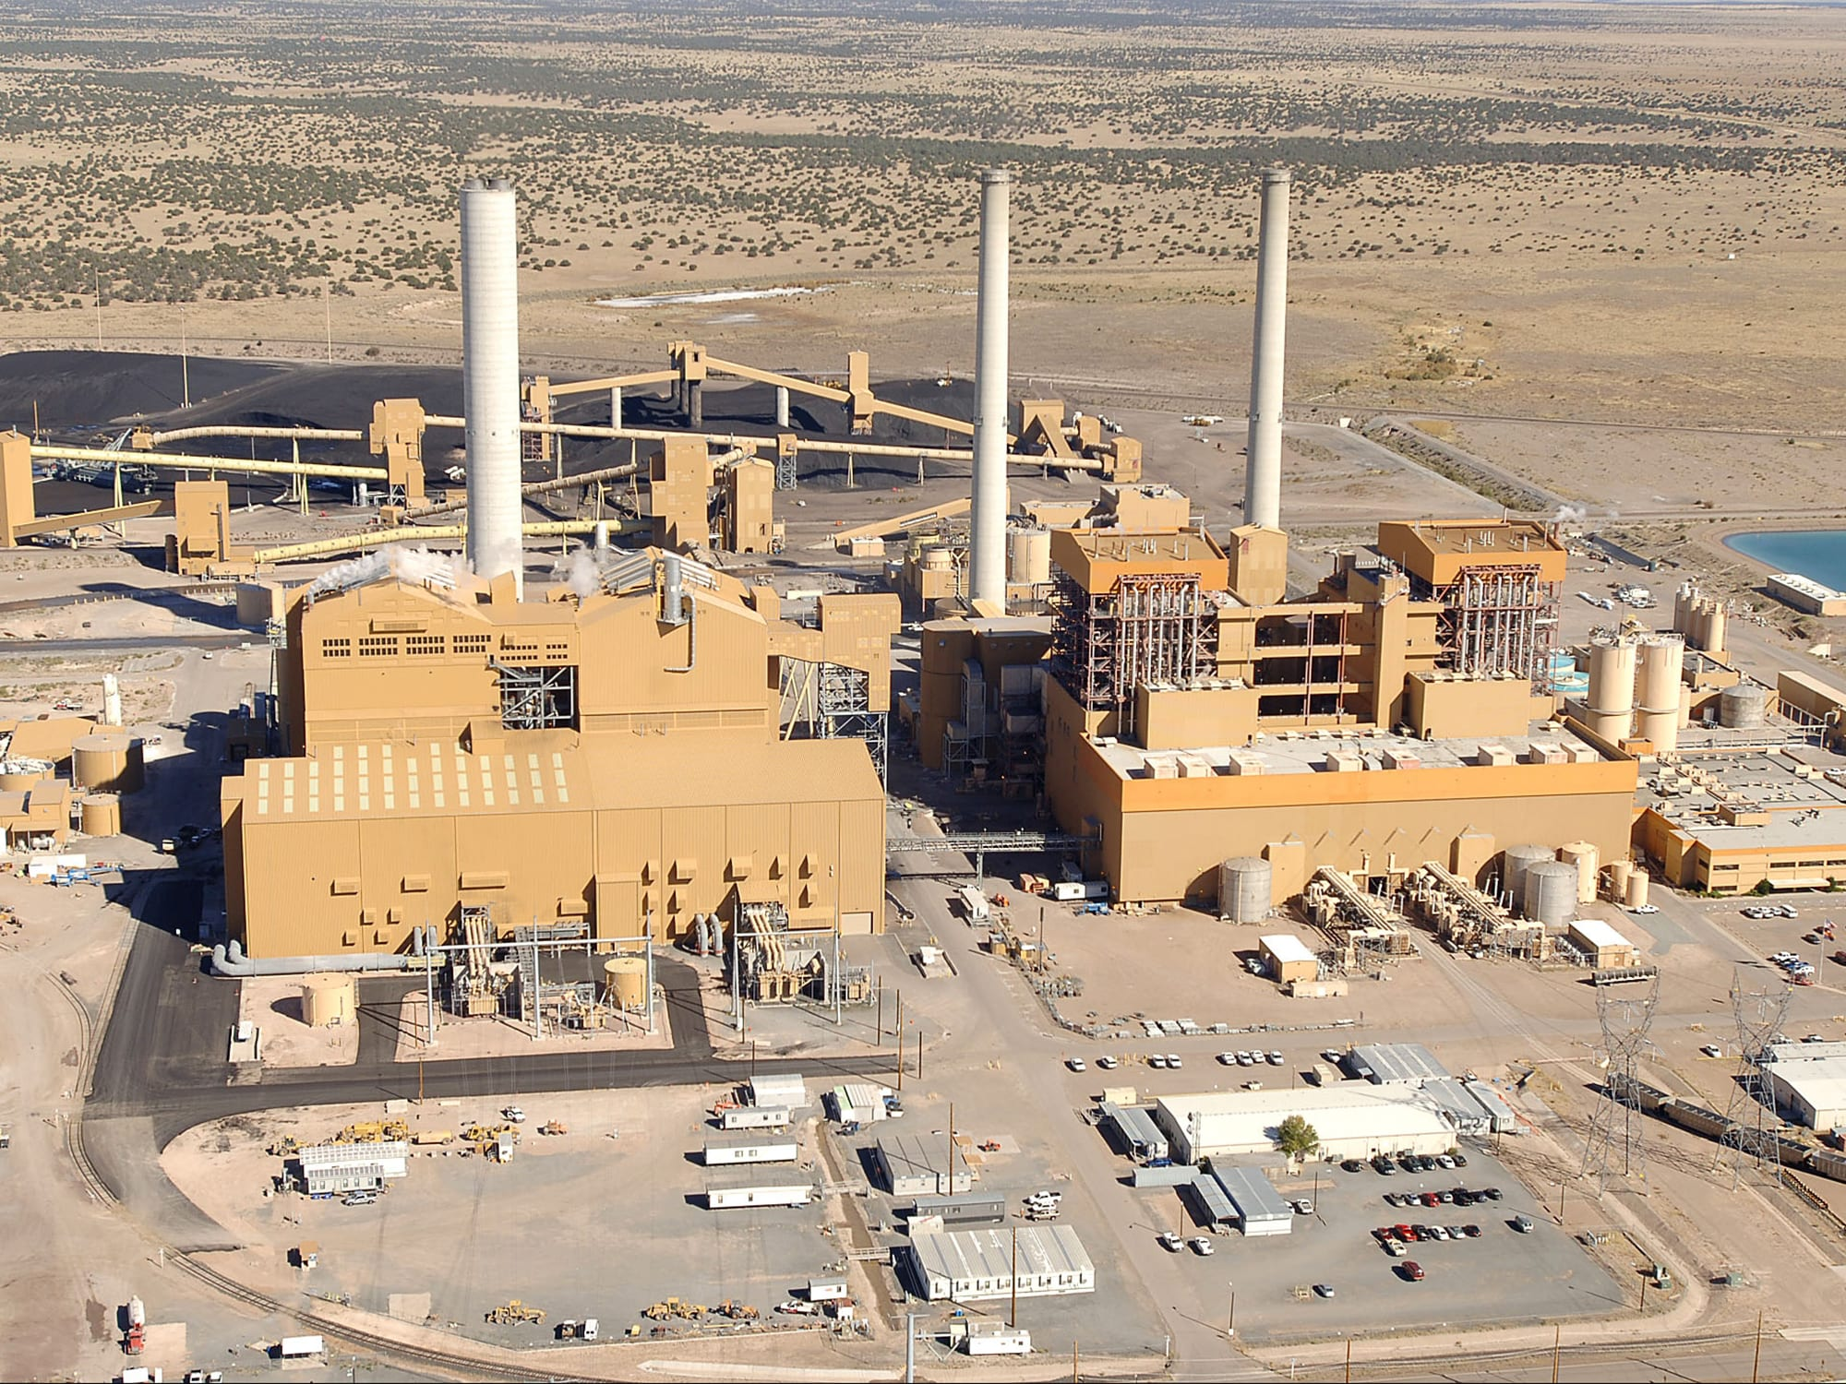
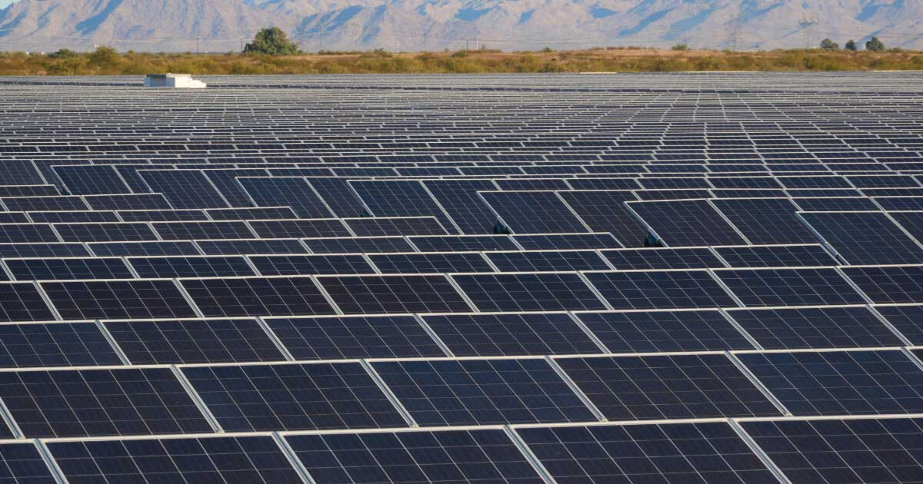
Predicting Arizona’s Energy Requirements Using US EIA Data for Electric Power Operations by Powerplant for Arizona (2001-2024)?
03.04.25
DAT 490 Torching Pandas Team:
Team Lead: Bryan Katterman
Analyst: Amilcar Hernandez
Analyst: Zoey Gabbard
Analyst: Kiara Zepeda

Slide 2
Agenda
Executive Summary
Research Questions
Methodology
Analysis and Visualization
Recommendations/Next Steps
Sources
1.
2.
3.
4.
5.
6.

Slide 3
Executive Summary
Capstone explores Arizona’s energy portfolio, analyzing power consumption & generation of various energy types
Analysis divided into 3 research questions:
Forecasting energy patterns (power consumption & generation)
Relationship between fuel type & heat content
Efficiency trends over time
EIA dataset (2001-2024) of Arizona Power Plants w/ over 100K observations
Models employed include:
2 RNN models: GRU & BRNN
Random Forest Model
2 time series models: ARIMA and SARIMA
Models evaluated w/ MSE, MAE & RMSE scores

Slide 4
Executive Summary
Relationship between fuel types & average heat content in Arizona’s power plants
Coal & gas produce over 70% of Arizona’s energy
Coal: 20-25 BTUs/ton, Natural gas: 1,030 BTUs/cu ft, Solar & wind: 0 BTUs
Weak correlation between heat content and energy output (R² = 0.05)
Denotes improvement of coal and gas efficiency, expanding solar, wind and battery storage and balancing efficiency, cost & sustainability.
With Arizona integrating sustainable energy, we analyzed power plant efficiency since 2001
Time series, decomposition, t-tests, and ANOVA methods used
Efficiency statistical significance improved over time, most improvement 2021 onward
SARIMA model predicted stabilization
Difficult modeling due to Arizona’s erratic weather patterns & uneven data reporting
Models performed well in 12 month historical data windows, but 12 month forecasts were unrealistically low
Significant underreporting w/ 2023 & 2024 data - possibly impacted predictions

Slide 5
Research Question 1: Forecasting Energy Patterns: How accurately can we forecast future energy consumption and production patterns using machine learning models?
Accurate energy forecasts are key to keeping the energy supply stable and efficient while helping policymakers and utilities plan ahead. By using machine learning to analyze historical data, we can spot trends and predict changes in energy consumption and production. This leads to better resource allocation, fewer electricity shortages, and improved grid management. Plus, solid forecasts support the shift to renewable energy by providing insights into how alternative energy sources can meet future demand.

Slide 6
Research Question 2: Fuel Type and Heat Content Relationship: What is the relationship between fuel type and the average heat content in Arizona's power plants, and how does this impact total energy production?
Different fuel types produce different amounts of energy based on their heat content, which affects how efficiently fuel is converted into electricity. Understanding these differences helps Arizona’s power plants choose the most efficient and cost-effective fuel sources. Smarter fuel selection means less waste and greater sustainability. Insights from this analysis can also shape policies that push for cleaner and more efficient energy production.

Slide 7
Research Question 3: Efficiency Trends Over Time: Has the efficiency of AZ power plants improved since 2001 (energy consumed vs generation) - or are we just ramping up production without efficiency?
Evaluating whether Arizona’s power plants have improved their efficiency over time is critical for measuring progress in energy management. If power plants produce more electricity with the same or less fuel, this indicates technological advances and better operating strategies. However if energy consumption increased without efficiency improvements, this may suggest inefficiencies or outdated infrastructure. Identifying these trends can help improve energy policies, infrastructure investment and sustainability efforts.

Slide 8
Methodology
Data Collection
Models and Neural Nets
Open Source API
Web Scraping
Local Downloads
Data Merging
Gated Recurrent Unit Neural Net
Bidirectional Neural Net
Random Forest Model
Exploratory Analysis
Statistical Testing
Breaking Down Variables
Data Visualization
Feature Extraction
T-Test
ANOVA
Pattern Analysis

Slide 9
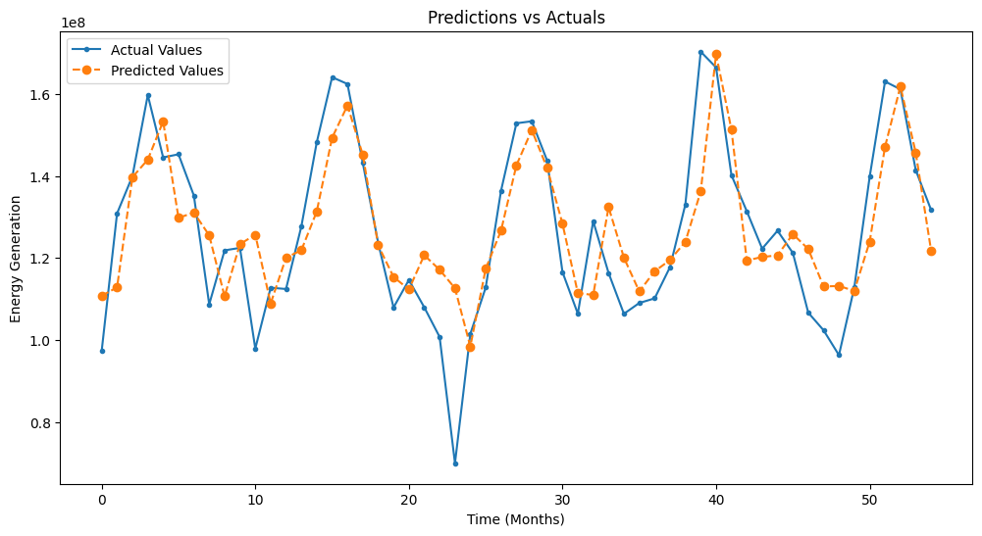
GRU Predictions On Historical Data
GRU’s process historical data windows (as opposed to individual points) through sequences.
Uses a 12 month sequence window
Splitting into 80% training and 20% testing, we used a RELU activation function, an MSE loss function, an Adam optimizer, and three dense layers with 64/32/16 neurons each.

Slide 10
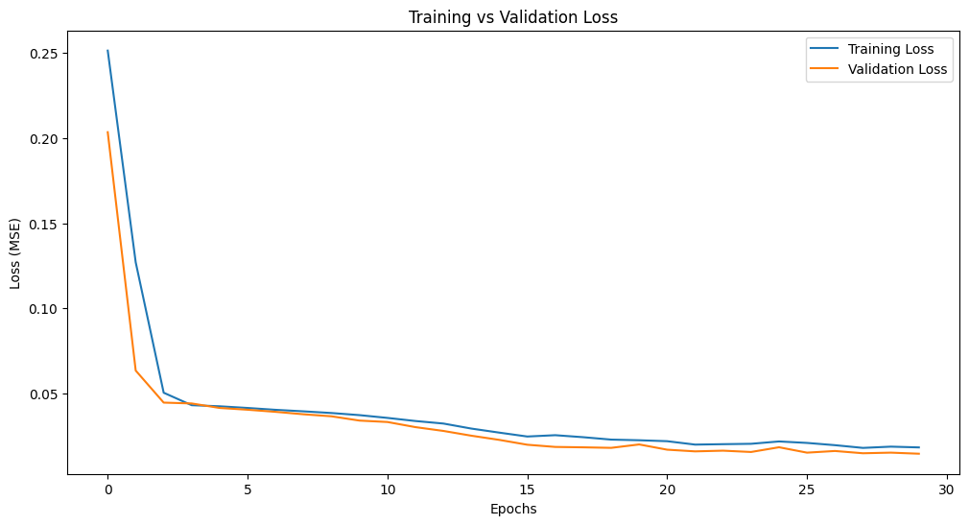
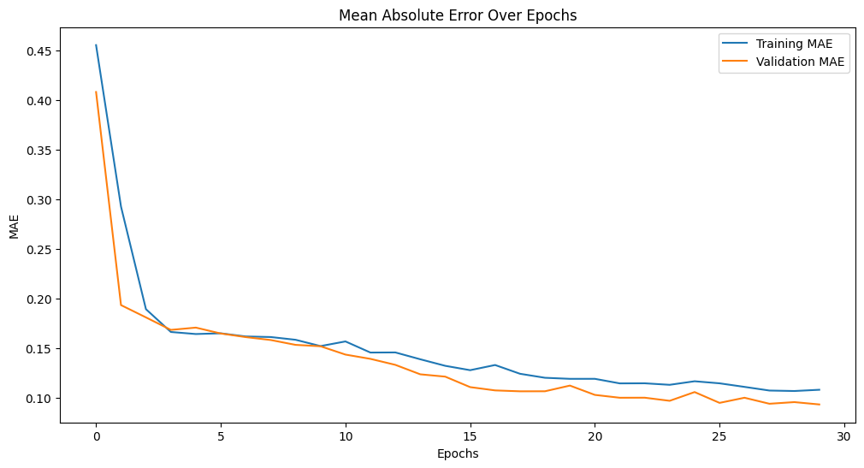
Loss and Accuracy of GRU
The model performed exceptionally well, achieving a validation data mean squared error of 0.00903690792620182, which is <0.01.
This means that the GRU net made predictions that were very close to the actual values.
The mean absolute error was acceptable but not ideal, scoring 0.07899285852909088, which is less than the standard pass of < 0.1.

Slide 11
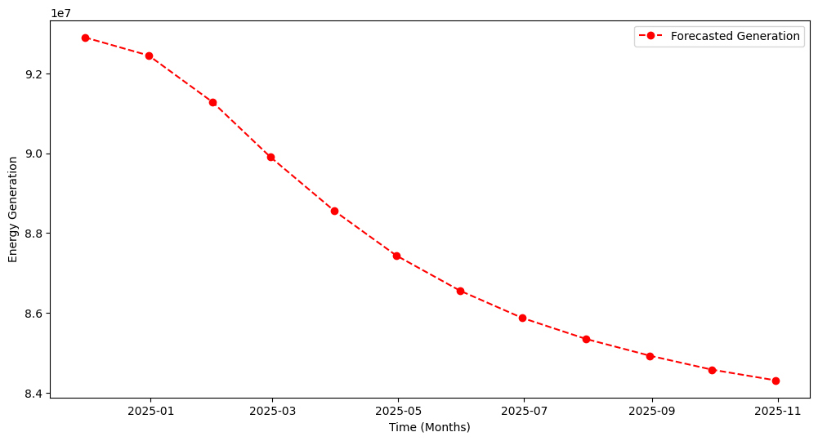
Forecasting Energy Generation
Forecasting forward by 12 months, the model’s results were odd. In a given 12 month span, it should have predicted spikes and ranges, similar to a sine curve.
However, it is a consistent downwards trend. This could be in part due to an unusual lack of data in the quoted 2024 year, which reported three times less than any of the previous five years.

Slide 12
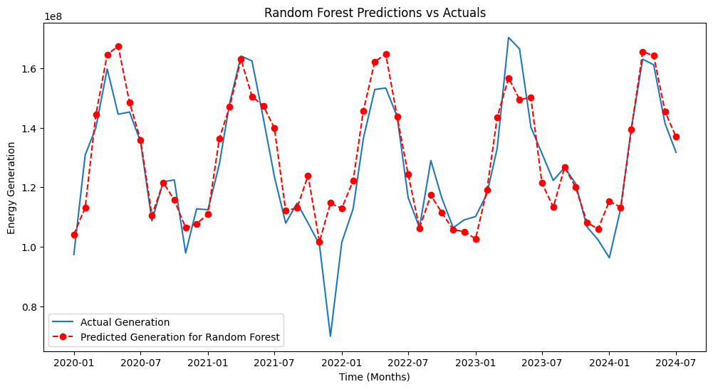
Random Forest
Using the same data pipeline, we used a vanilla Random Forest skeleton from sklearn. We reshaped the data from time series dimension into two dimensional data input, and predicted values from 2020 to 2024.
This model also performed exceptionally well. However, the Random Forest model is not built to make forecasting predictions. It is a classifying predictor, and can be set against our GRU model to assess if the RF predicted values were consistent with the values predicted by the GRU.

Slide 13
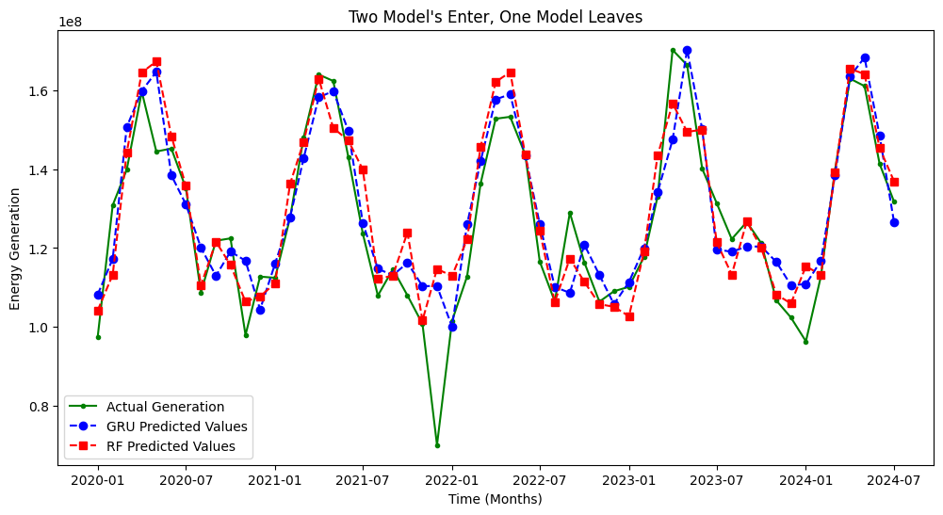
GRU vs Random Forest
We layered the two predictions against each other and saw that they were highly compatible, giving us confidence in the GRU’s capabilities. The odds of GRU’s stellar predictive skills spelling out an energy crisis could indeed be possible (but highly improbable when in comparison to non-2024 energy output years).

Slide 14
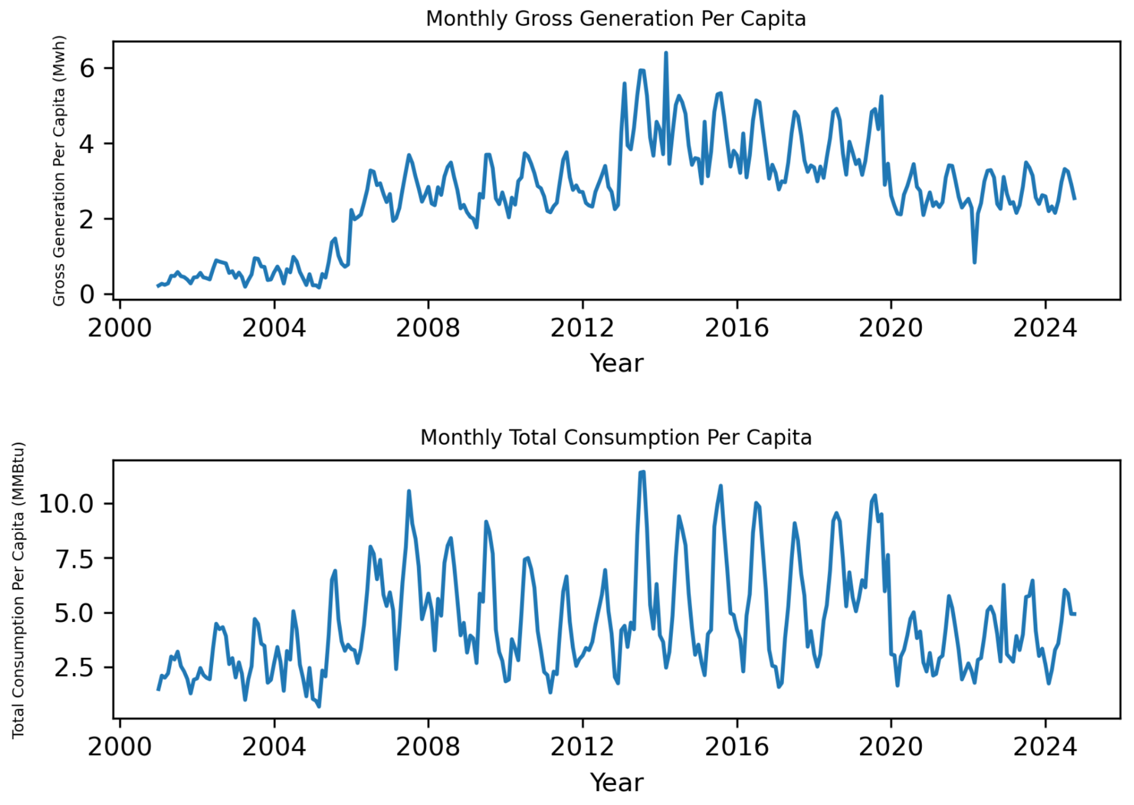
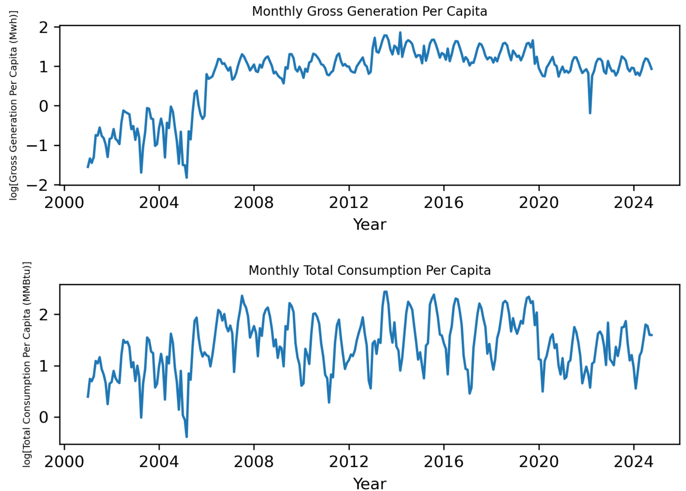
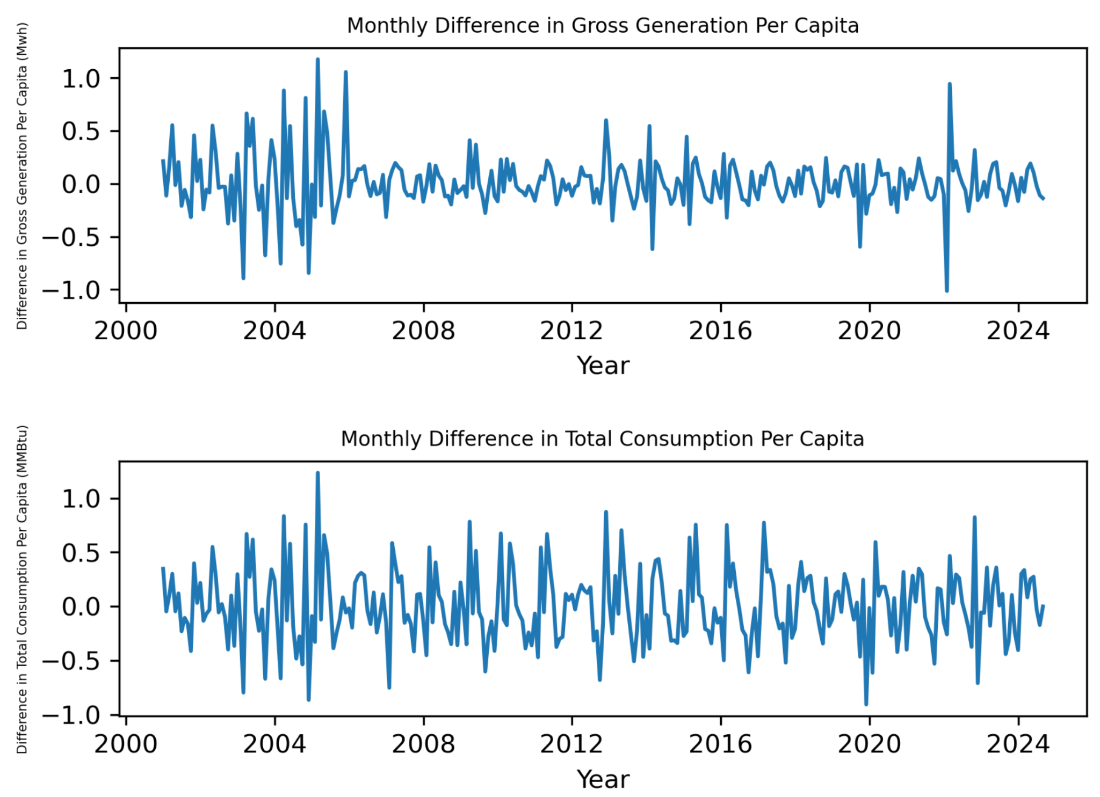
ARIMA Time Series Analysis
Research Question 1: Forecasting Energy Patterns: How accurately can we forecast future energy consumption and production patterns using machine learning models?
First step - stationarity testing
Determined by Augmented Dickey-Fuller unit root tests
Original data fails test
P-values: 0.237 (Generation) & 0.061 (Consumption)
Log transformation performs slightly worse than original
P-values: 0.248 (Generation) & 0.076 (Consumption)
Difference method proves successful
P-values: 9.340e-05 (Generation) & 7.301e-07 (Consumption)

Slide 15
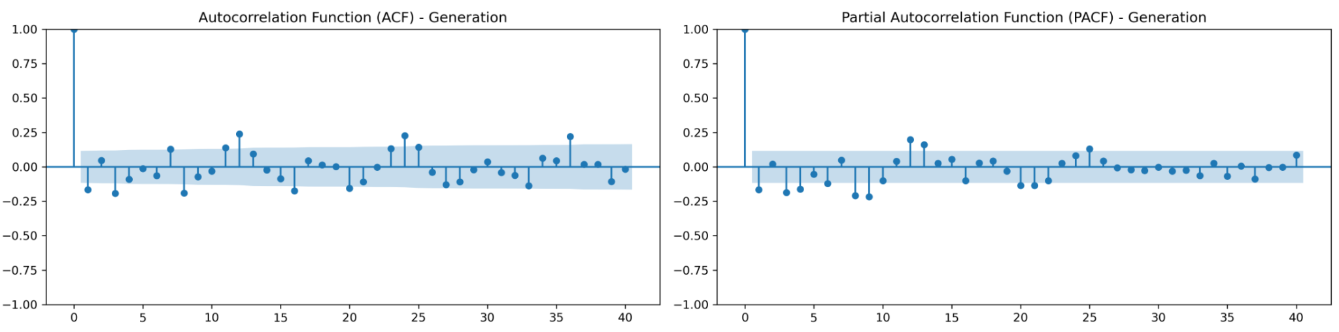
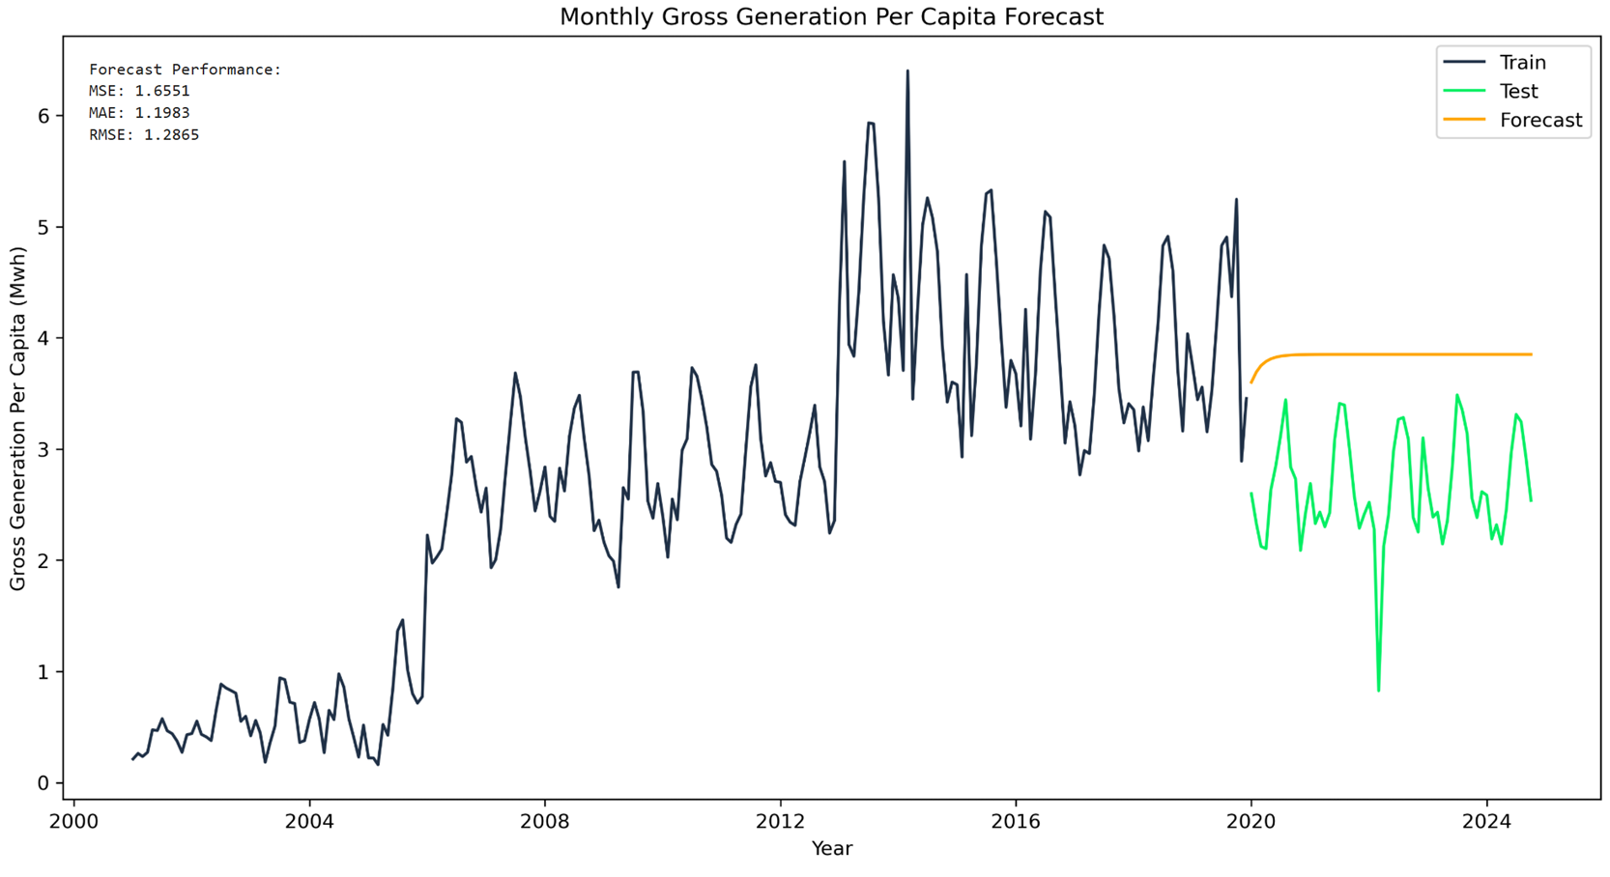
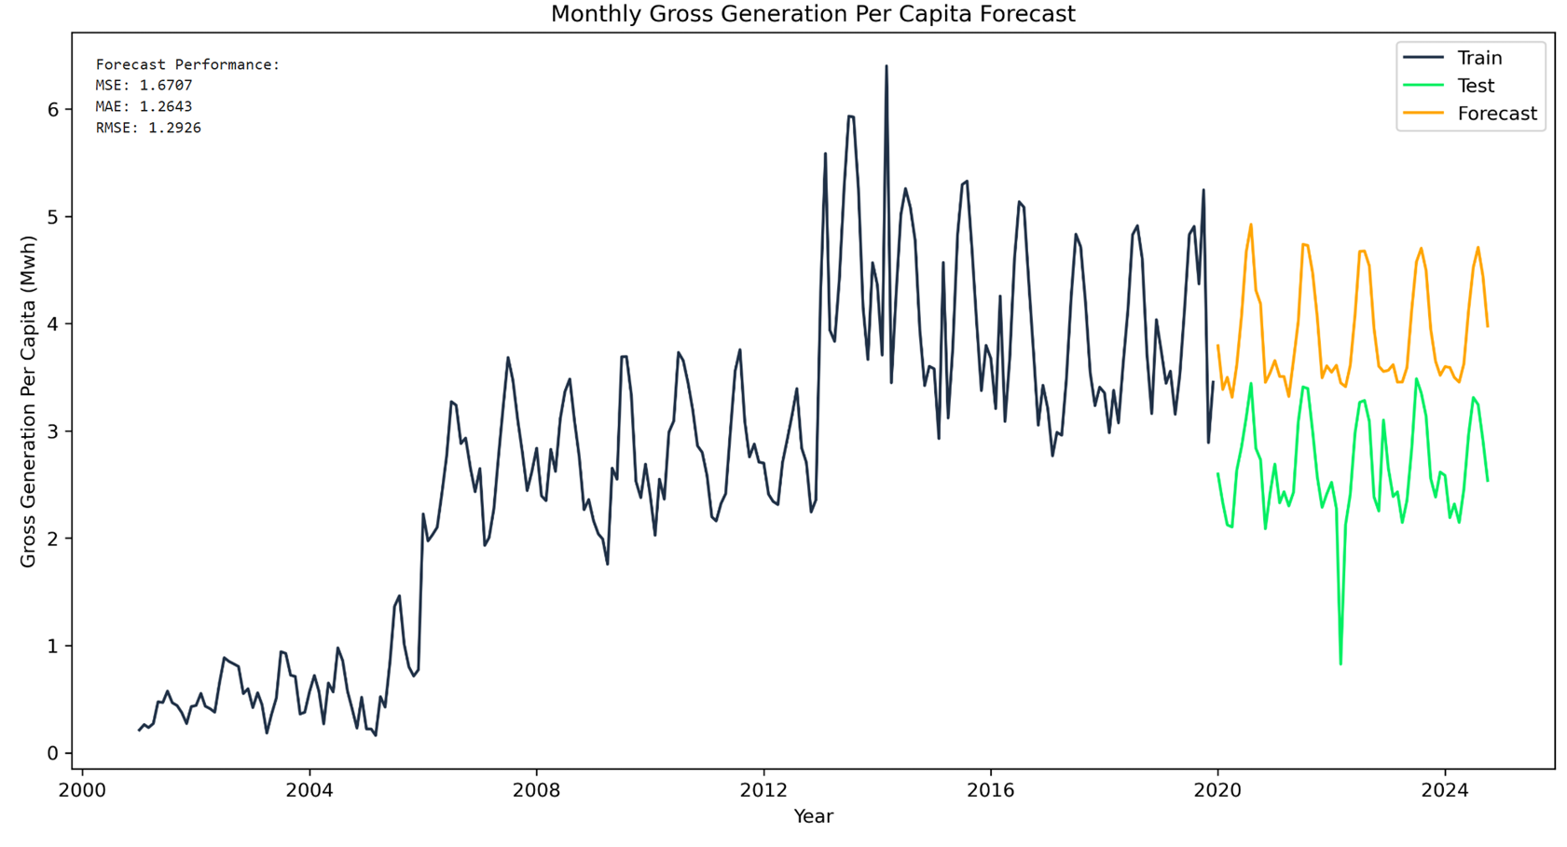
ARIMA Time Series Analysis
Research Question 1: Forecasting Energy Patterns: How accurately can we forecast future energy consumption and production patterns using machine learning models?
Fitting ARIMA model
P & Q initially set to 1
Flat, non-useful forecast data
P & Q values increased accounting for all points on ACF and PACF outside of significance area
More useful forecast curves
Not aligned with Test curve
Performance values slightly worse for Generation data

Slide 16
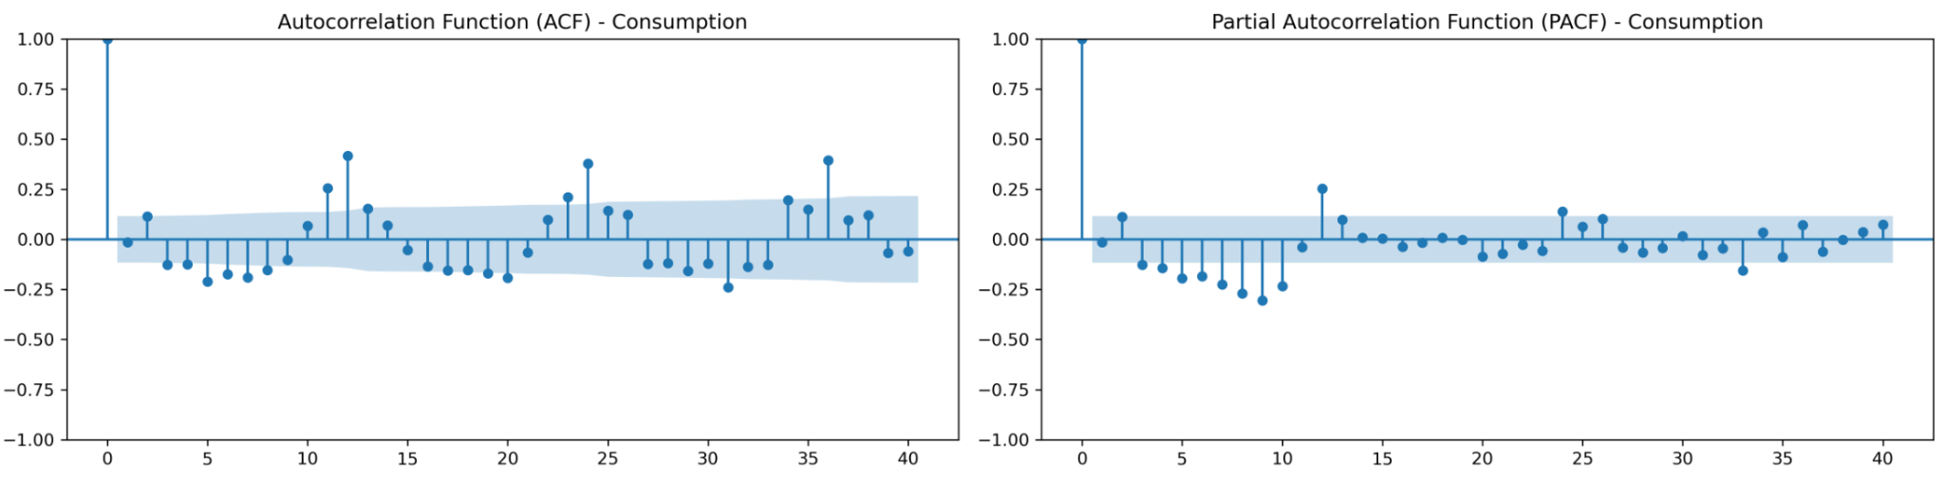
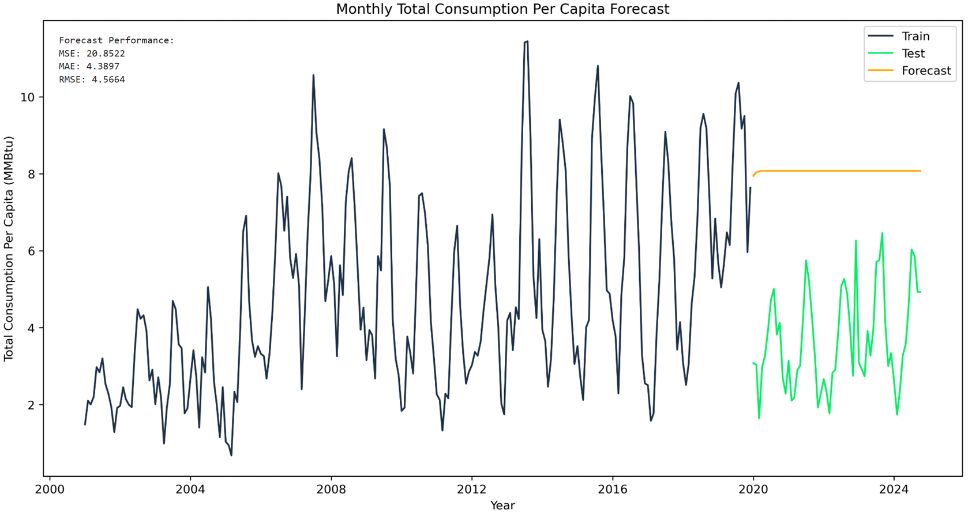
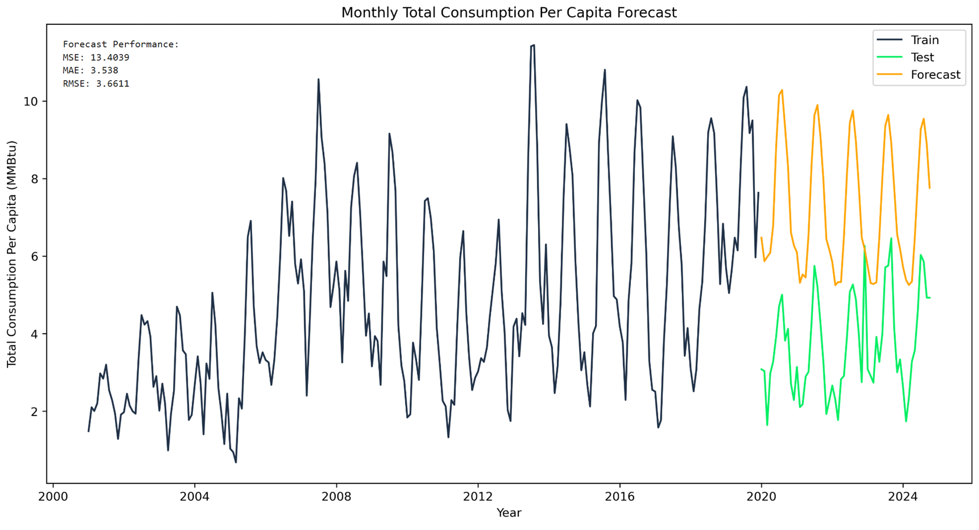
ARIMA Time Series Analysis
Research Question 1: Forecasting Energy Patterns: How accurately can we forecast future energy consumption and production patterns using machine learning models?
Fitting ARIMA model (cont)
P & Q initially set to 1
Flat, non-useful forecast data
P & Q values increased accounting for all points on ACF and PACF outside of significance area
More useful forecast curves
Not aligned with Test curve
Performance values slightly improved for Consumption data

Slide 17
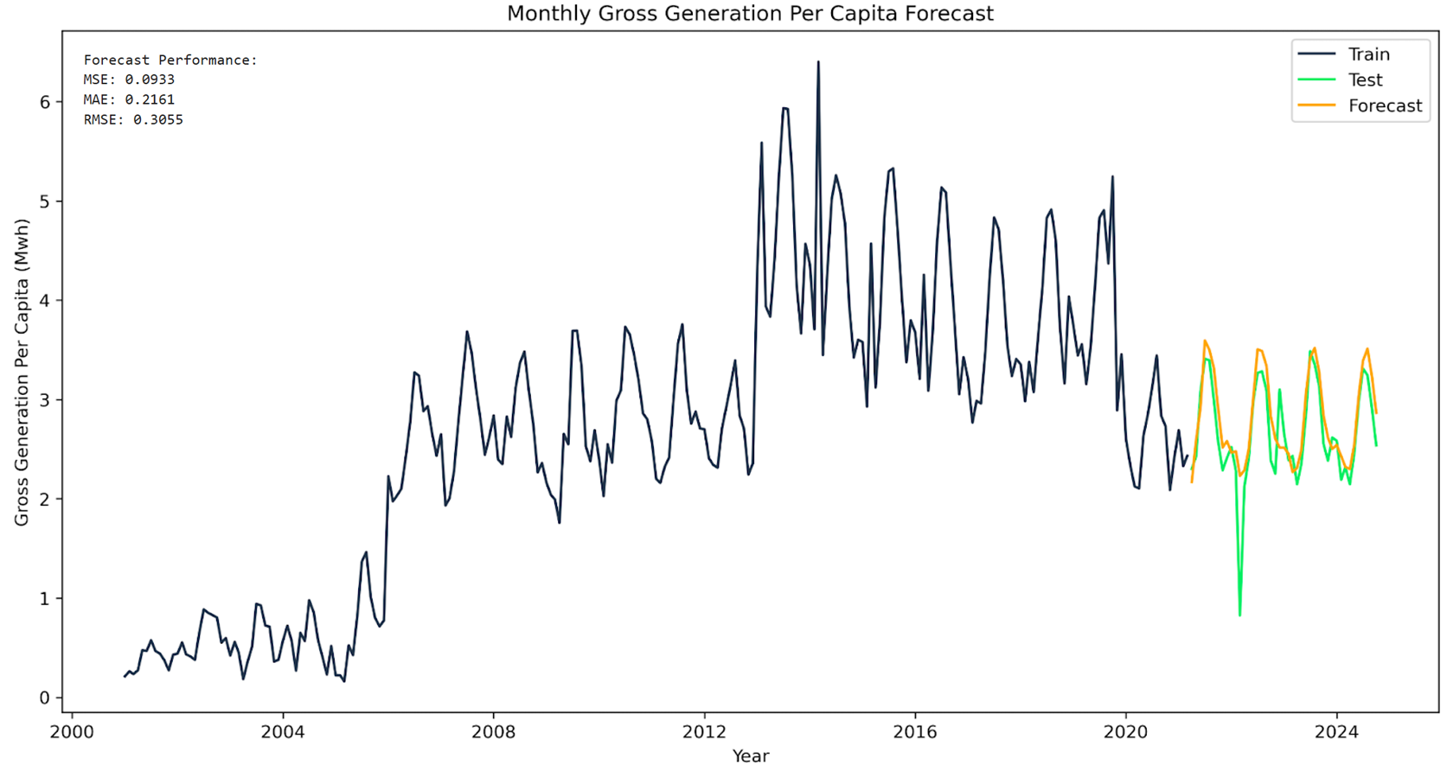
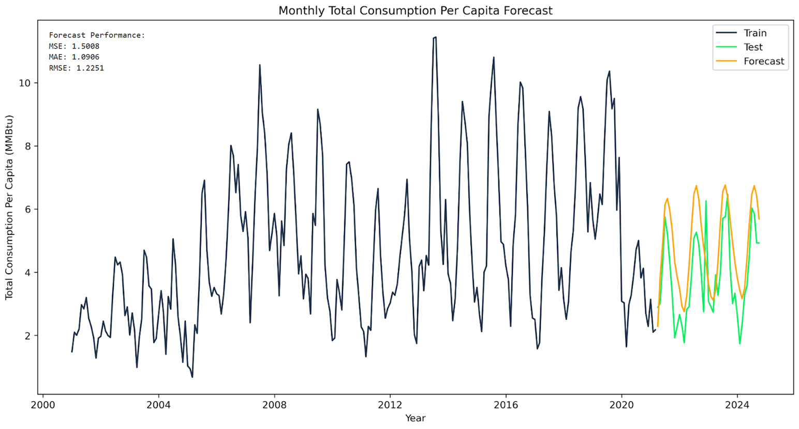
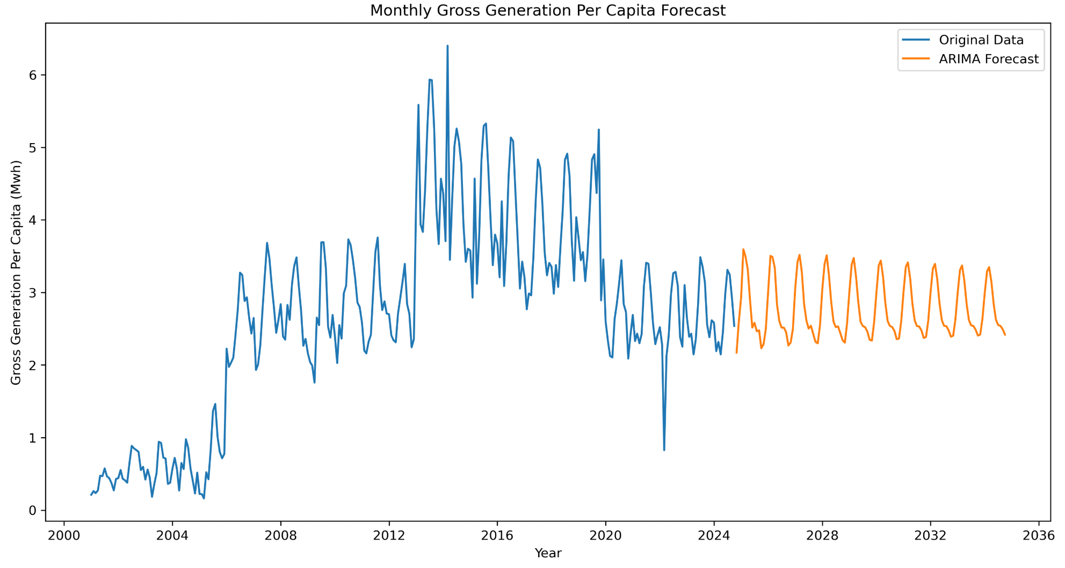
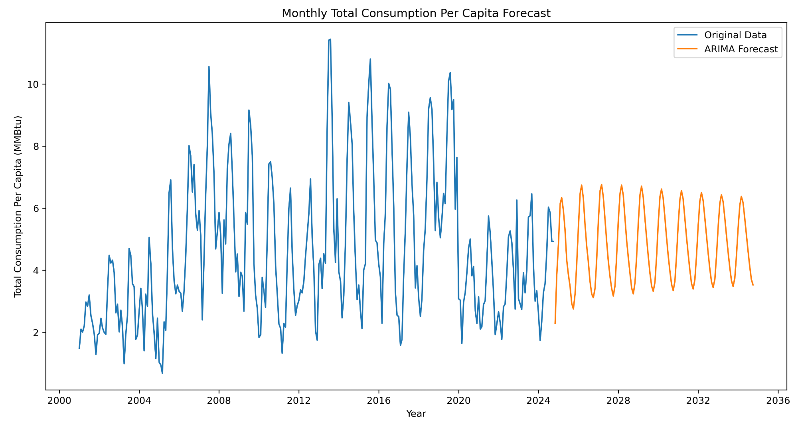
ARIMA Time Series Analysis
Research Question 1: Forecasting Energy Patterns: How accurately can we forecast future energy consumption and production patterns using machine learning models?
Training increased to 85% to account for behavior shift that occurs at 80% timeframe
Better forecast alignment and model performance values
Forecast produces damped harmonic motion-like cycles
Model will need continual revision to be useful as a predictive tool

Slide 18
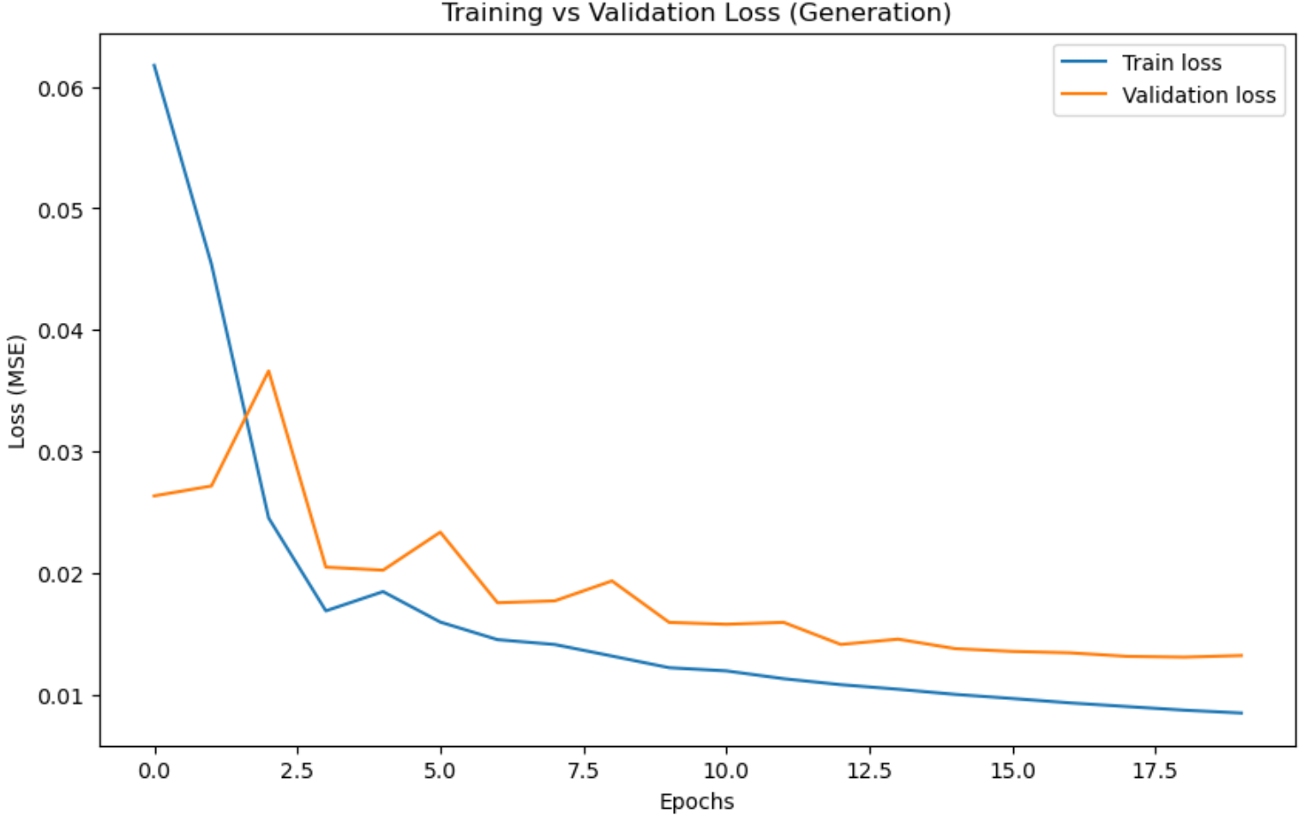
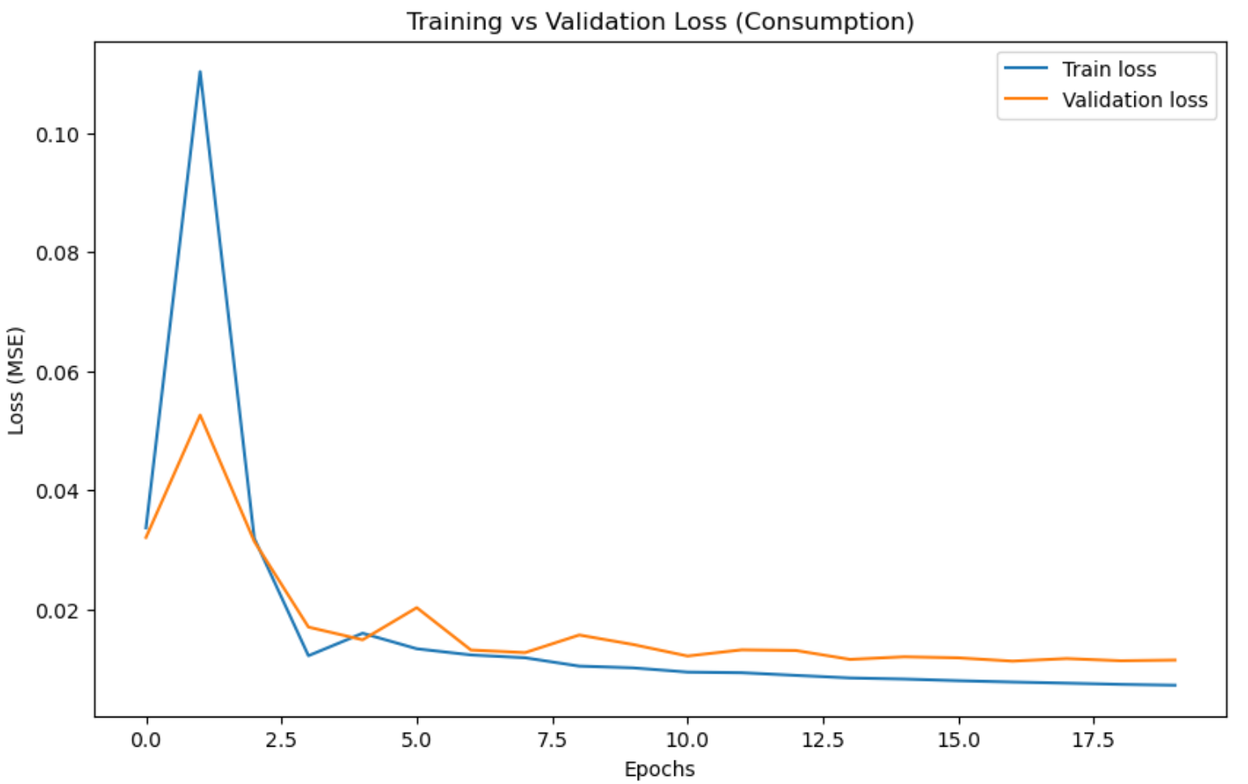
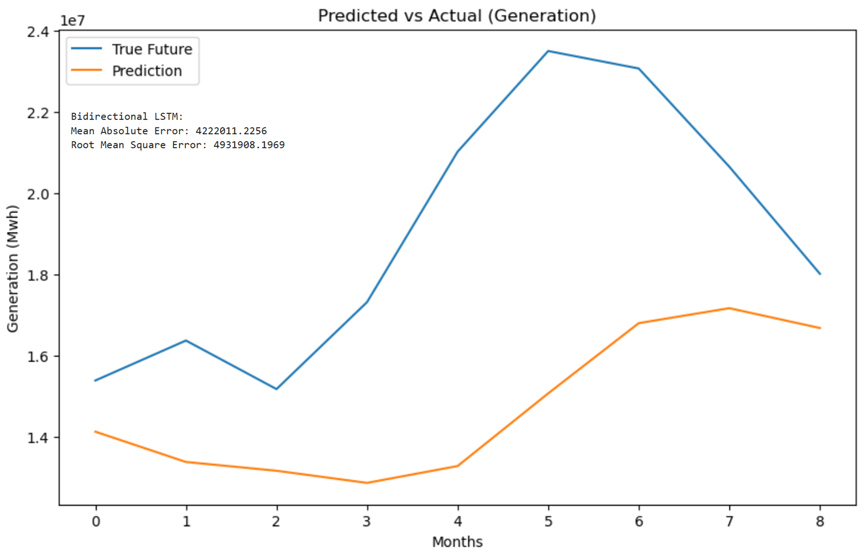
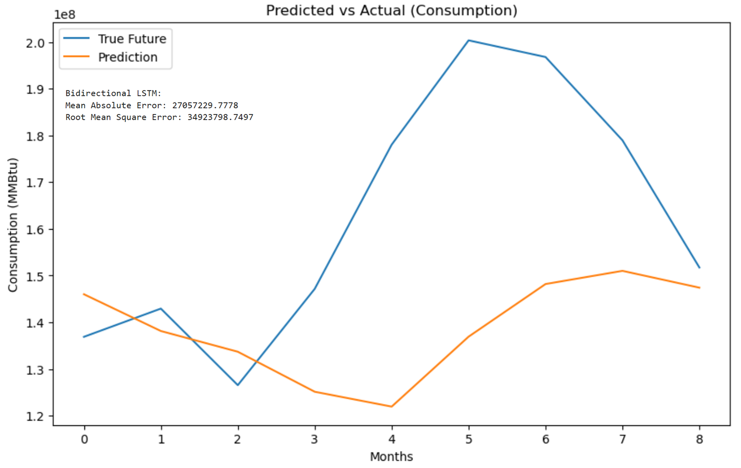
Bi-directional Recurrent Neural Network (BRNN)
Research Question 1: Forecasting Energy Patterns: How accurately can we forecast future energy consumption and production patterns using machine learning models?
Attempted BRNN w/ environmental data for last model
Min, max & ave temperature
Precipitation
Thunderstorms per month
Ave & max wind speeds
85% training model using Keras w/ Tensorflow.
Initial attempts included all environmental variables
Single variables also attempted without success

Slide 19
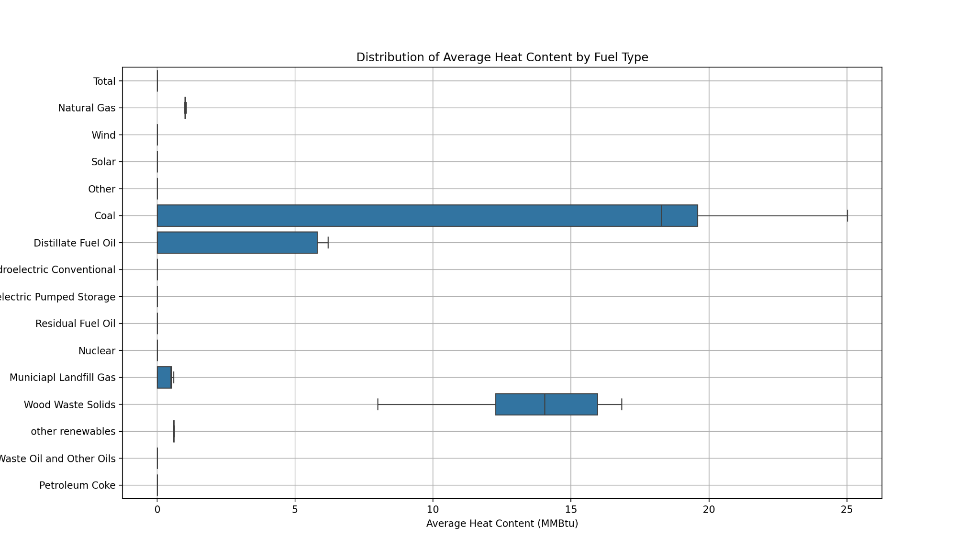
Distribution of Average Heat Content by Fuel Type
Research Question 2: Fuel Type and Heat Content Relationship: What is the relationship between fuel type and the average heat content in Arizona's power plants, and how does this impact total energy production?
The Distribution of Average Heat Content by Fuel Type indicated that coal and natural gas dominate energy production due to their higher heat content and efficiency with calculating coal 20-25 million BTUs per ton and natural gas at around 1,030 per cubic foot.

Slide 20
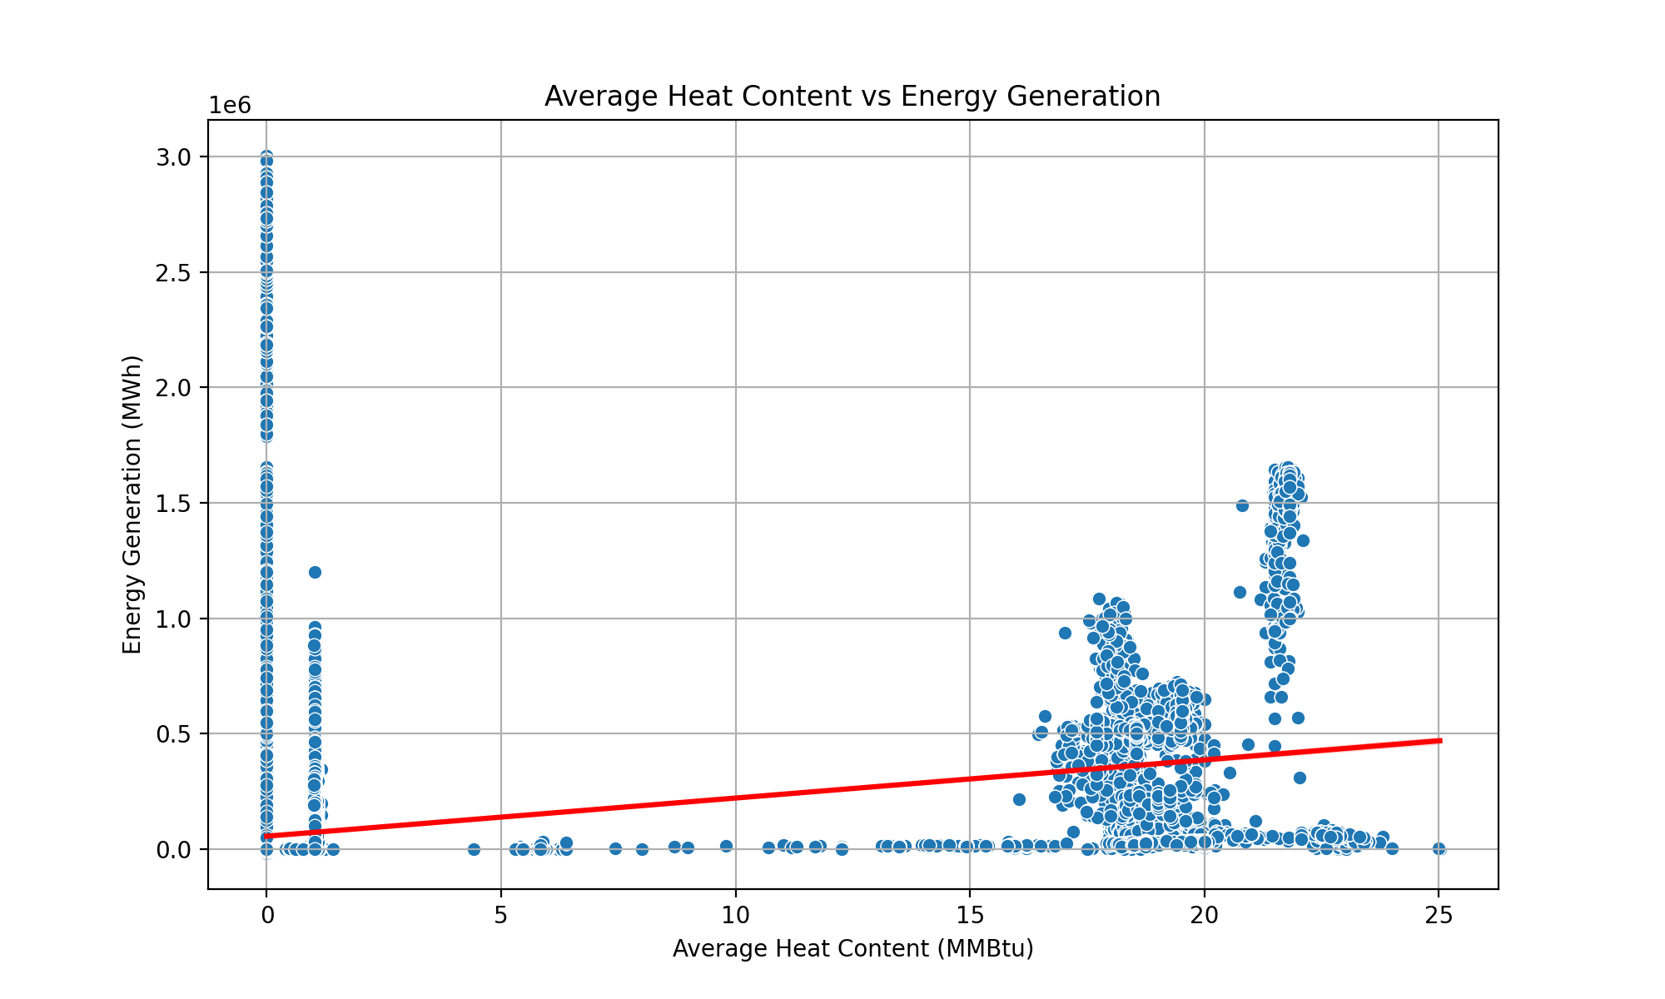
Average Heat Content vs Energy Generation
Research Question 2: Fuel Type and Heat Content Relationship: What is the relationship between fuel type and the average heat content in Arizona's power plants, and how does this impact total energy production?
The Scatter Plot, Average Heat Content vs. Energy Generation indicates the weak correlation (R2 = 0.05) that factors beyond heat content significantly influence energy output.

Slide 21
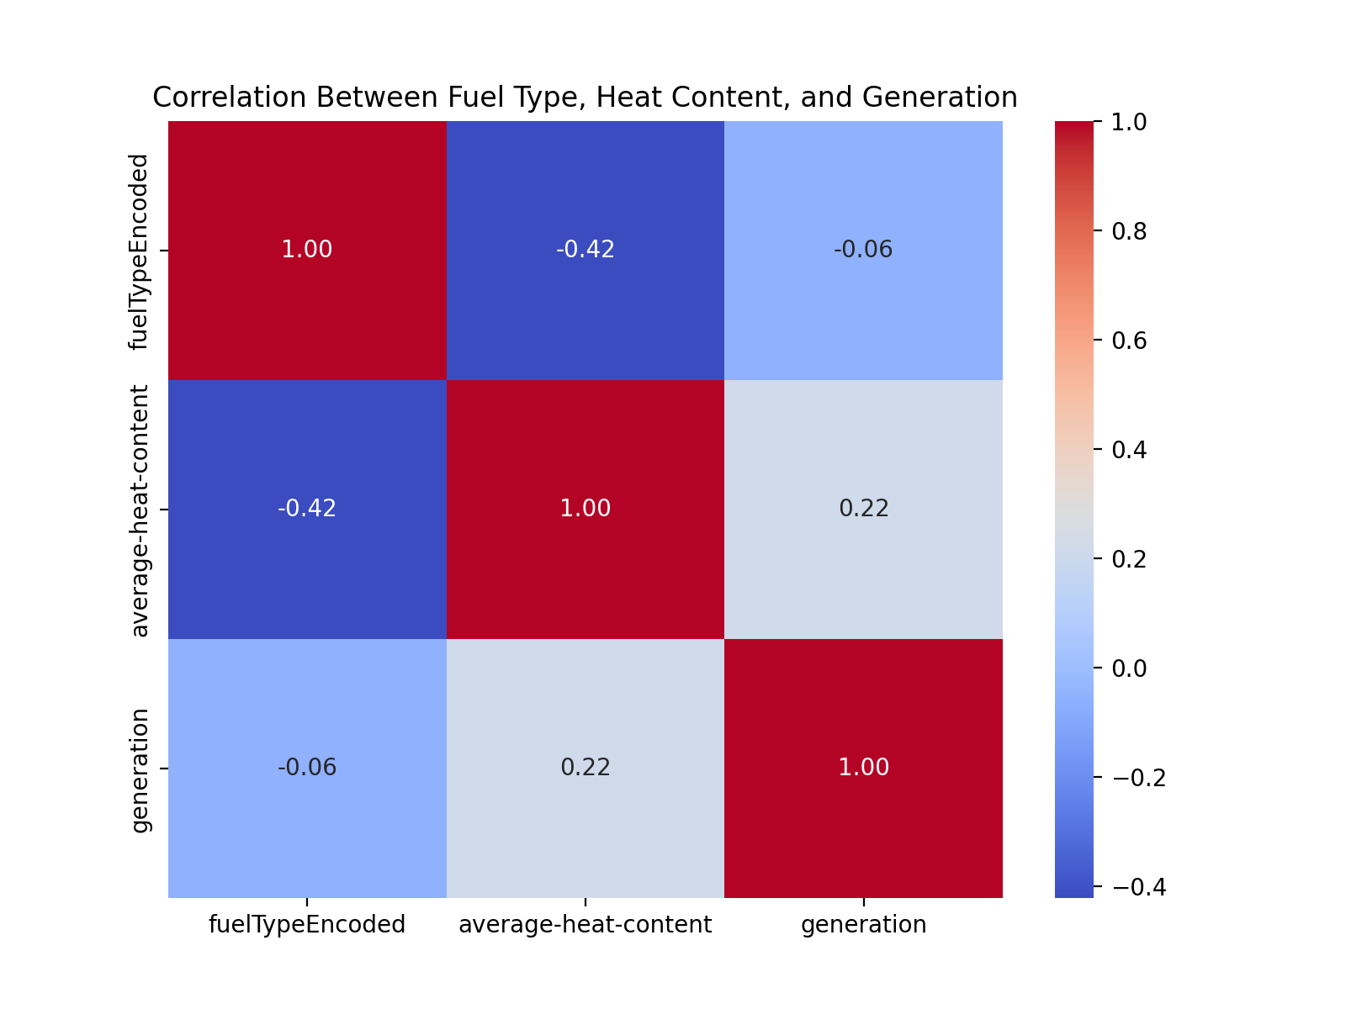
Correlation Between Fuel Types, Heat Content and Energy Generation
Research Question 2: Fuel Type and Heat Content Relationship: What is the relationship between fuel type and the average heat content in Arizona's power plants, and how does this impact total energy production?
The Correlation Between Fuel Types, Heat Content, and Energy Generation indicates a stronger ability to convert heat into energy between coal and natural gas, highlighting the need for a balanced energy mix to combine efficiency with environmental sustainability.

Slide 22
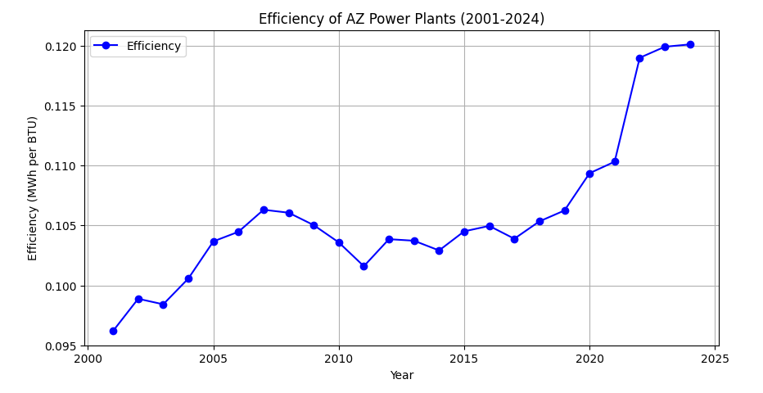
Efficiency of Arizona Power Plants
Research Question 3: Efficiency Trends Over Time: Has the efficiency of AZ power plants improved since 2001 (energy consumed vs generation) - or are we just ramping up production without efficiency?
The time series graph highlighted fluctuations but a general upward trend in efficiency through the years 2001-2024. We calculated efficiency as the ratio of generation to total-consumption-BTU.

Slide 23
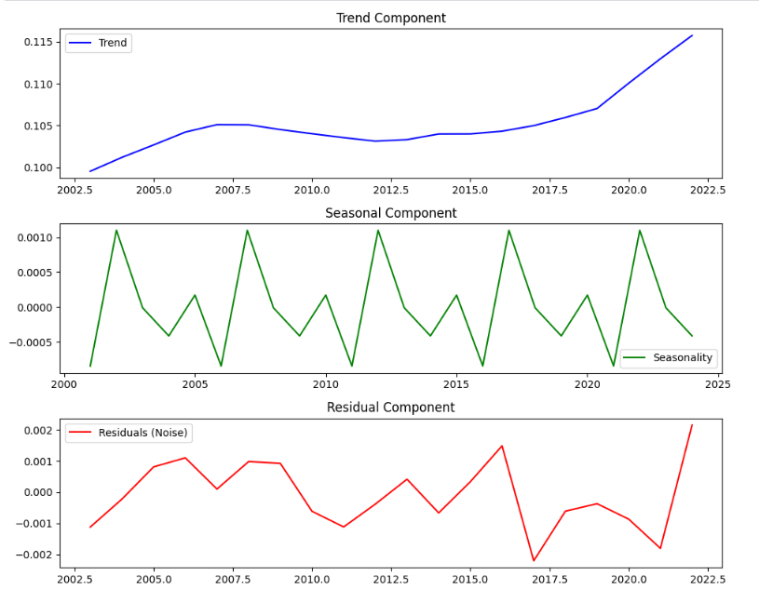
Time Series Decomposition
Research Question 3: Efficiency Trends Over Time: Has the efficiency of AZ power plants improved since 2001 (energy consumed vs generation) - or are we just ramping up production without efficiency?
The trend component reveals a long-term upward movement, indicating overall improvement over time. The seasonal component follows a repeating pattern every five years, while the residuals show deviations not explained by seasonality or trend. These may suggest random variations or external influences.

Slide 24
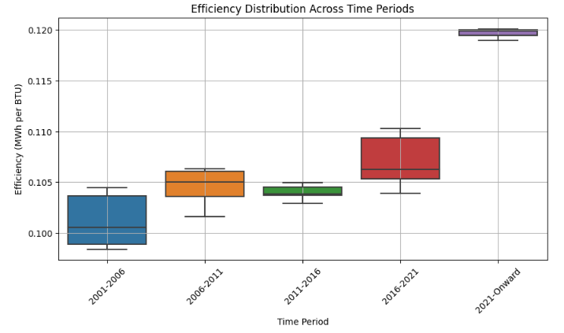
Efficiency Distribution
Research Question 3: Efficiency Trends Over Time: Has the efficiency of AZ power plants improved since 2001 (energy consumed vs generation) - or are we just ramping up production without efficiency?
After we split the data into five groups, we graphed them into box plots and performed an ANOVA test. These further showed that at least one group is statistically, significantly different and it is suggested that the years 2021-2024 have the greatest increase in efficiency.

Slide 25

Recommendations/Next Steps
Individual analysis of plants
Enhance forecasting models
Gather missing data
Invest in clean energy storage and renewable energy initiatives

Slide 26
Sources
NOAA Local Climatological Data. Retrieved from: https://www.ncdc.noaa.gov/cdo-web/datatools/lcd
Arizona State Energy Profile. Retrieved from: https://www.eia.gov/state/print.php?sid=AZ
EIA Open Data API Dashboard. Retrieved from: https://www.eia.gov/opendata/browser/electricity/facility-fuel?frequency=monthly&data=average-heat-content;consumption-for-eg;consumption-for-eg-btu;generation;gross-generation;total-consumption;total-consumption-btu;&facets=state;&state=AZ;&start=2001-01&end=2024-10&sortColumn=period;&sortDirection=desc;
data accessed 26 January 2025

